Slide 1
Interest rate derivatives!
Random Rates and Black’s Model

Slide 2
Q1: Interest Rate Tree!
The current 1 year rate is 6%.
You propose an interest rate model that each year the 1-year interest rate could go up or down by 1% with a 50% chance.
Given the above interest rate model find the prices of zero coupon bonds with maturities 1, 2 and 3 years.

Slide 3
Q2: Implied Yield Curve
Calculate the implied yield curve from the interest rate model in Q1.
Suppose that the 1, 2 and 3 year zero rates are 6%, 7% and 8% respectively (yield curve in the market).
Does the implied yield curve agree with the market yield curve?
How would you calibrate the model?

Slide 4
Call on a stock with random rates
Assume a non-dividend paying stock is trading at $100. The volatility of the stock is 40%. The risk free rate is 5%. A call option with strike $100 is expiring in 2 years.
The 1-year risk free rate is 5%. One year later the 1-year interest rate could be 6% or 4% each with a 50% probability. (Assume that this gives the correct yield curve in the market!).
Price the call option using a 2-step tree.
How will you solve this?

Slide 5
Interest Rate Dilemma
What is the problem with interest rate models?

Slide 6
Black’s Model for call on stock with random rates
By working in a world that is forward risk neutral with respect to a P(0,T) it can be seen that Black’s model is true when interest rates are stochastic provided that the forward price of the underlying asset has a constant volatility
c = P(0,T)[F₀N(d₁)−KN(d₂)]
p = P(0,T)[KN(−d₂) − F₀N(−d₁)]

Slide 7
Black’s model for stock options (random rates)
The 1-year futures price of a stock is $56
The futures price volatility is 15%
The strike price of a 1-year european call option is $50
Interest rates are stochastic!
What is the price of the call option?
Price of 1-yr bond with FV $1 is 0.95.

Slide 8
Option on a bond
Price a 2-year call option on a 3-year zero coupon bond with strike price of $94. FV of the bond is $100.

Slide 9
Black’s Model for European Bond Options
Assume that the future bond price is lognormal
Both the bond price and the strike price should be cash prices not quoted prices

Slide 10
Price an option on a bond
Use the Black’s model to value a one-year European put option on a 10-year bond. Assume that the current value of the bond is $125, the strike price is $110, the one-year interest rate is 10% per annum, the bond’s forward price volatility is 8% per annum, and the present value of the coupons to be paid during the life of the option is $10.

Slide 11
Answer
In this case F0 = (125 – 10)* exp(0.1x1) = 127.09
K= 110
σ_{B} = 0.08
P(0,T) = P(0,1) = exp(-0.1x1)
d1 = 1.8456
d2 = 1.7656
Value of put = 0.12

Slide 12
Caps and Floors
A cap is a portfolio of call options on LIBOR. It has the effect of guaranteeing that the interest rate in each of a number of future periods will not rise above a certain level
Payoff at time t_{k+1} is Lδ_{k} max(R_{k}−R_{K}, 0) where L is the principal, δ_{k} =t_{k+1} − t_{k} , R_{K} is the cap rate, and R_{k} is the rate at time t_{k} for the period between t_{k} and t_{k+1}
A floor is similarly a portfolio of put options on LIBOR. Payoff at time t_{k+1} is
Lδ_{k} max(R_{K} − R_{k} , 0)

Slide 13
Caplets
A cap is a portfolio of “caplets”
Each caplet is a call option on a future LIBOR rate with the payoff occurring in arrears
When using Black’s model we assume that the interest rate underlying each caplet is lognormal

Slide 14
Black’s Model for Caps
The value of a caplet, for period (t_{k}, t_{k+1}) is
The value of a floorlet is
F_{k} : forward interest rate
for (t_{k}, t_{k+1})
σ_{k} : forward rate volatility
L: principal
R_{K} : cap rate
δ_{k}=t_{k+1}-t_{k}

Slide 15
Interest Rate Cap
Calculate the price of an option that caps the three-month rate, starting in 15 months’ time, at 13% (quoted with quarterly compounding) on a principal amount of $1,000. The forward interest rate for the period in question is 12% per annum (quoted with quarterly compounding), the 18-month risk-free interest rate (continuously compounded) is 11.5% per annum, and the volatility of the forward rate is 12% per annum.

Slide 16
Black’s Model for European Swaptions
When valuing European swap options it is usual to assume that the swap rate is lognormal
Consider a swaption which gives the right to pay s_{K} on an n -year swap starting at time T. The payoff on each swap payment date is
where L is principal, m is payment frequency and s_{T} is market swap rate at time T

Slide 17
Black’s Model for European Swaptions
The value of the swaption where holder has right to pay s_{K} is LA[s₀N(d₁)−s_{K} N(d₂)]
The value of a swaption where the hold has the right to receive s_{K} is LA[s_{K}N(−d₂)−s₀ N(−d₁)]
s₀ is the forward swap rate; σ is the forward swap rate volatility; t_{i} is the time from today until the ith swap payment.

Slide 18
Interest rate models
Continuous time derivation of implied yield curve
Hard to balance the upward sloping nature of yield curve and mean reversion in interest rates
Easier to use multi factor models to achieve balance
Introduces complexity of correlations among the factors

Slide 19
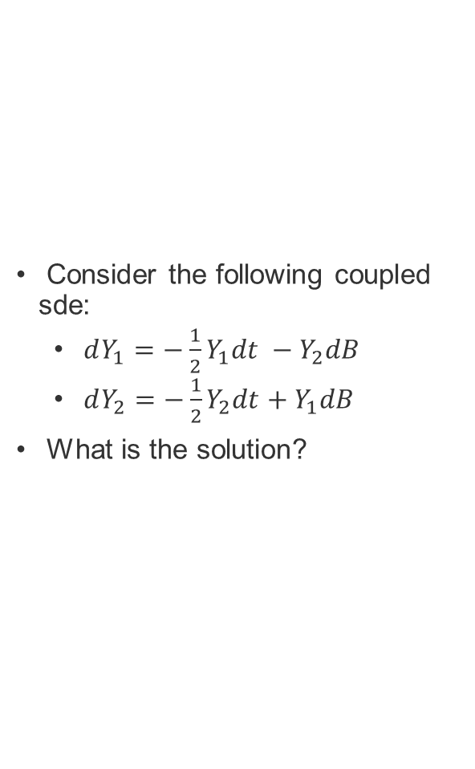
Coupled sde
Consider the following coupled sde:
$dY_{1}=−\frac{1}{2}Y_{1}dt −Y_{2}dB$
$dY_{2}=−\frac{1}{2}Y_{2}dt+Y_{1}dB$
What is the solution?

Slide 20
Philosophical Conflict
Black: Martingale Approach
Vasicek: Fit History: Equilibrium Models
Interest Rate Models
Hull:Fit Yield Curve: No Arbitrage Models

Slide 21
Equilibrium vs No-Arbitrage Models
In an equilibrium model today’s term structure is an output
In a no-arbitrage model today’s term structure is an input

Slide 22

Interest rate models
Ho-Lee Model (No Arb)
Vasicek (Equilibrium)
Cox-Ingersoll-Ross (Equilibrium)
Redleman Barter (Equilibrium)
Hull White (No Arb)

Slide 23
The correlation problem
Explain the problem with multifactor models.
Discuss the correlation problem.
Correlation estimation remains one of the hardest problems in finance.
Propose a method of pricing that bypasses the correlation problem!

Slide 24
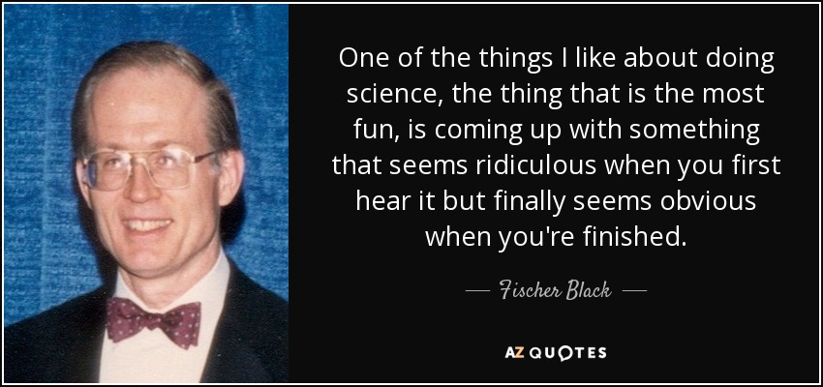
Fisher Black

Slide 25
HJM Model: Notation
P(t,T ): | price at time t of a discount bond with principal of $1 maturing at T
Ω_{t} : | vector of past and present values of interest rates and bond prices at time t that are relevant for determining bond price volatilities at that time
v(t,T,Ω_{t} ): | volatility of P(t,T)

Slide 26
Notation continued
ƒ(t,T₁,T₂): | forward rate as seen at t for the period between T₁ and T₂
F(t,T): | instantaneous forward rate as seen at t for a contract maturing at T
r(t): | short-term risk-free interest rate at t
dz(t): | Wiener process driving term structure movements

Slide 27
Modeling Bond Prices

Slide 28
The process for F(t,T)

Slide 29
The LIBOR Market Model and HJM
In the limit as the time between resets tends to zero, the LIBOR market model with rolling forward risk neutrality becomes the HJM model in the traditional risk-neutral world

Slide 30
Monte Carlo for LMM Model

